Slide 1
Using Augmented Reality to improve the lives of elderly people

Slide 2
“an enhanced version of the physical world that is achieved through the use of digital visual elements, sound, or other sensory stimuli delivered via technology”

Slide 3
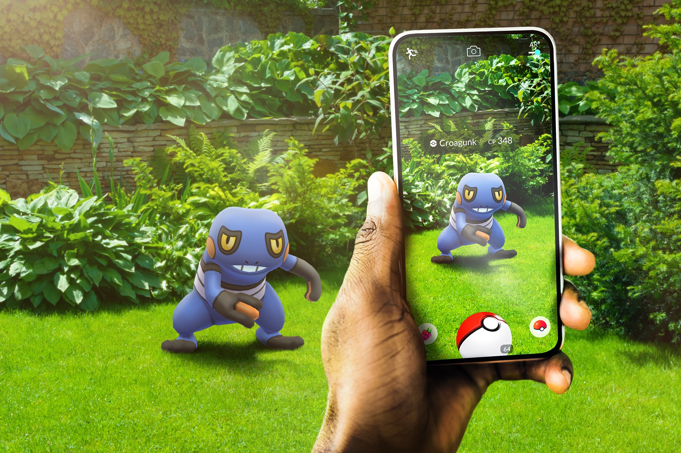

Slide 4
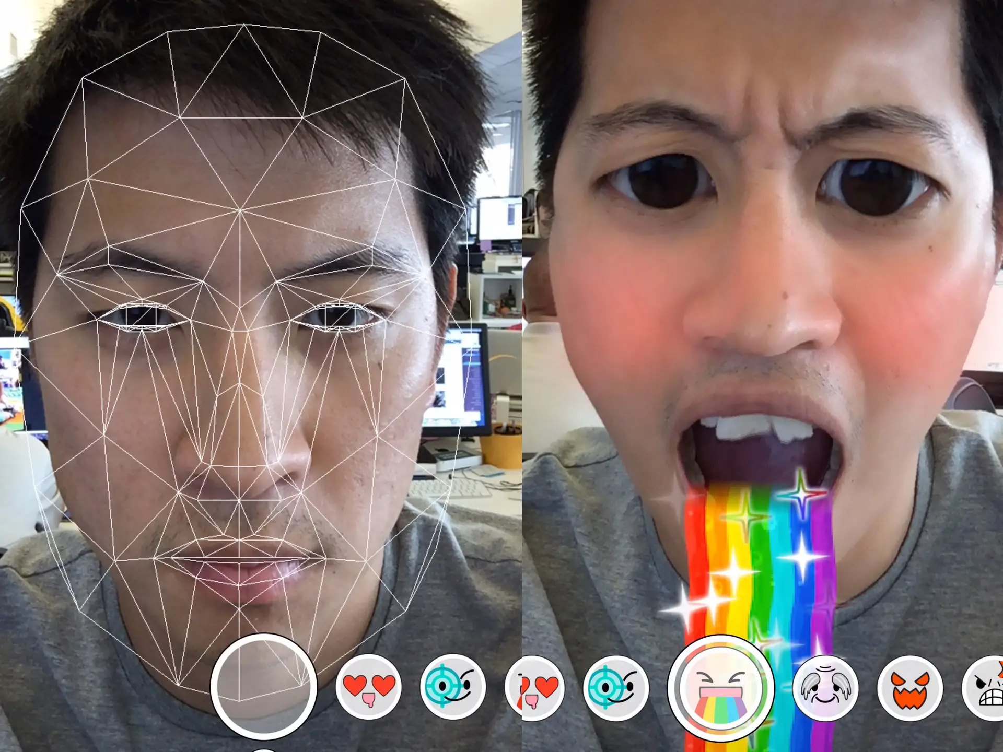

Slide 5
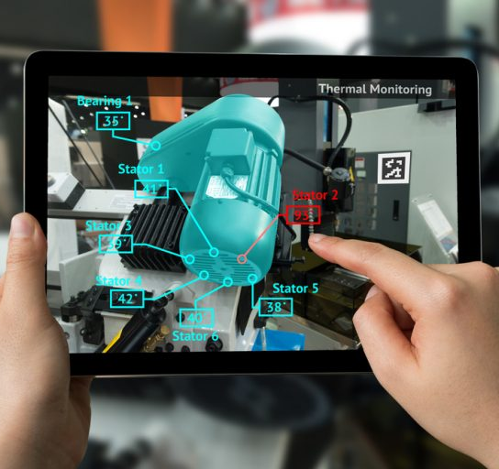
Improving Aspects of People’s Lives

Slide 6
How can we improve aspects of elderly people’s lives?

